Slide 1


Mathematical Analysis and Theoretical Trade-offs of Activation Functions in Neural Networks: Convergence Behavior and Gradient Dynamics
Project – Theoretical Machine Learning (DASC 5420)

Slide 2
Team & Course Info
Instructor: Yue Zhang
Course: Theoretical Machine Learning (DASC 5420)
Team Members:
Arpitha Thippeswamy - T00749833
Sree Aryan SP - T00751318
Shashank Manjunatha - T00728166
Jiayi Zhang -

Slide 3
Objectives
Study theoretical and empirical properties of activation functions
Evaluate convergence speed and gradient dynamics
Compare ReLU, Sigmoid, Tanh, Leaky ReLU, and Swish
Guide selection of activation functions for deep learning

Slide 4

METHODOLOY & CODE IMPLEMENTATION

Slide 5
Methodology
1. Mathematical Derivation of Activation Functions
2. Empirical Evaluation using CIFAR-10
3. Gradient Flow & Stability Analysis
4. Optimization & Computational Trade-offs

Slide 6
Dataset & Preprocessing
Dataset: CIFAR-10 (60,000 images, 10 classes)
Steps: Normalization, Data Augmentation, Data Loader setup
Goal: Improve generalization, training stability

Slide 7
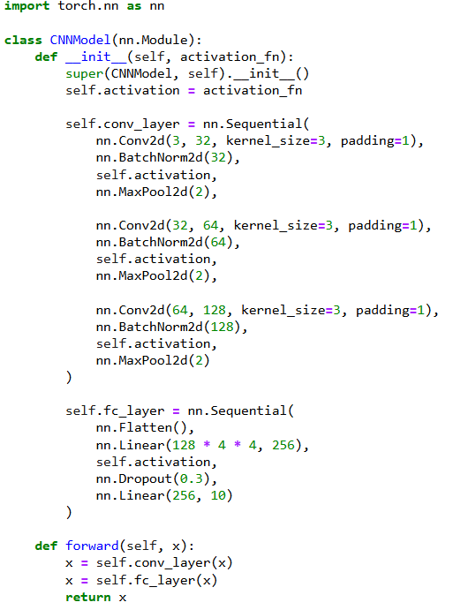
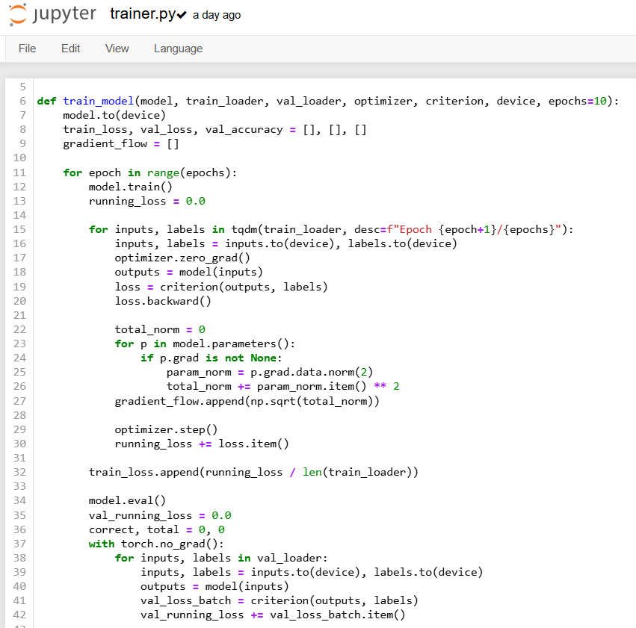
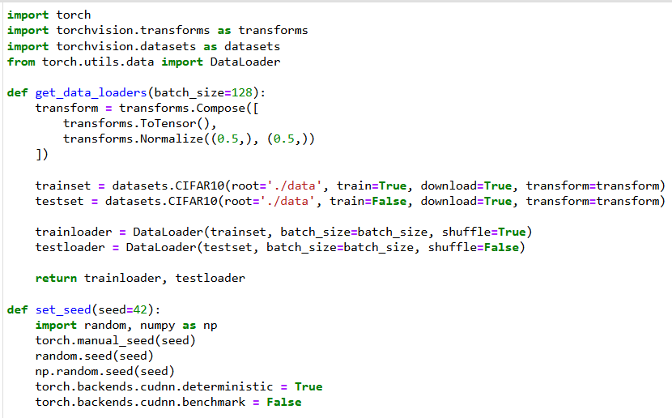
model_builder.py
trainer.py
utils.py
Data Processing & Model Development
model_builder.py – defines the CNN with customizable activation functions.
utils.py – loads CIFAR-10 and sets random seeds
trainer.py – trains the model and tracks loss, accuracy and gradients.

Slide 8
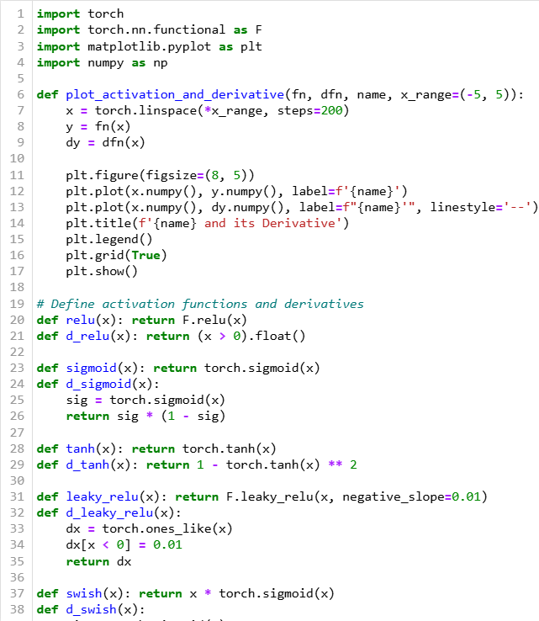
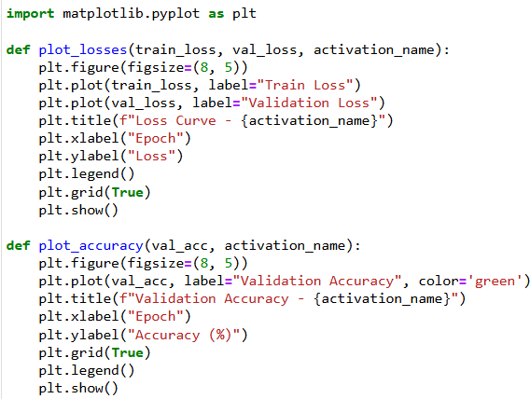
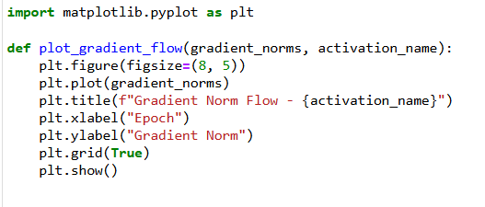
Visualization 1. activation_derivatives.py – plots each activation function and its first derivate to analyze smoothness,saturation and gradient behaviour. 2. gradient_flow.py – plots the gradient norm over training epochs to assess learning activity and detect vanishing gradients. 3. loss_plots.py – visualizes training/validation loss and accuracy over epochs to monitor model convergence and generalization
activation_derivative.py
loss_plots.py
gradient_flow.py

Slide 9
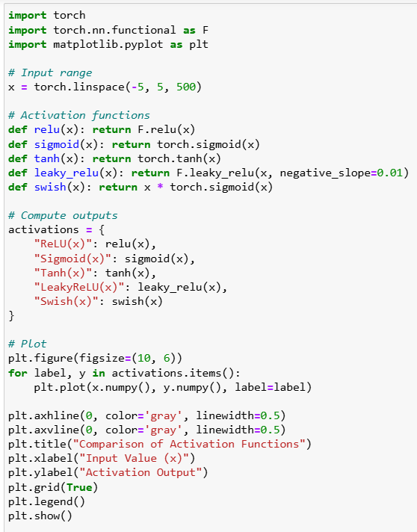
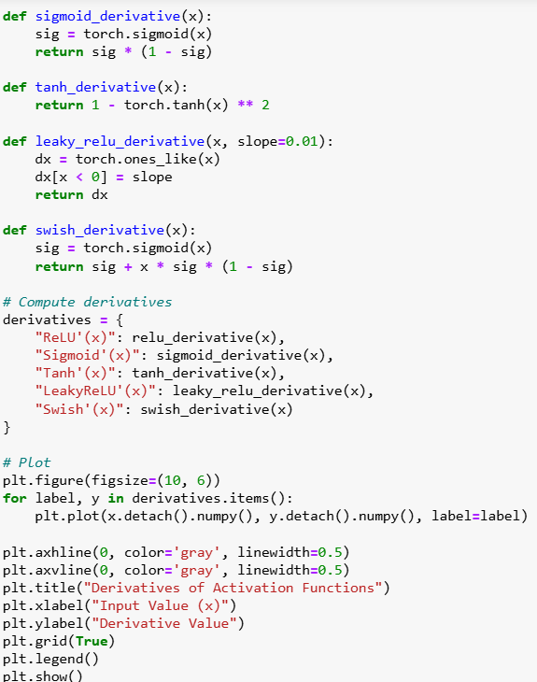
combined_plots.py – plots combined derivatives for all activation functions and comparison plot.

Slide 10
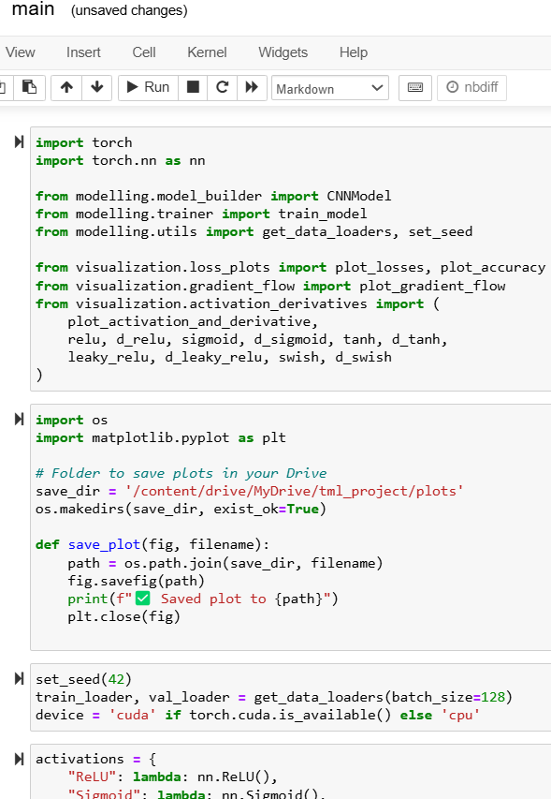
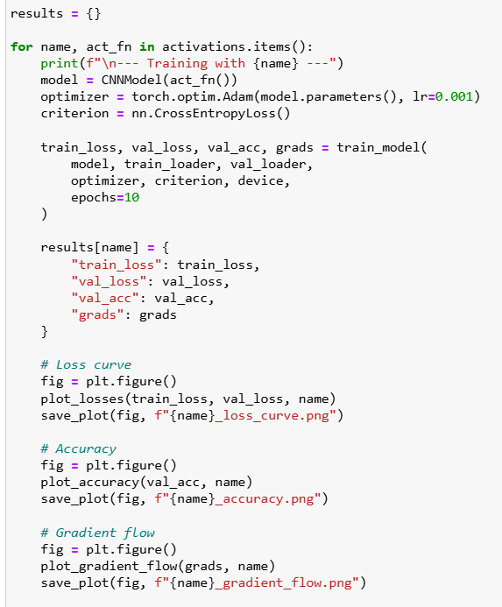
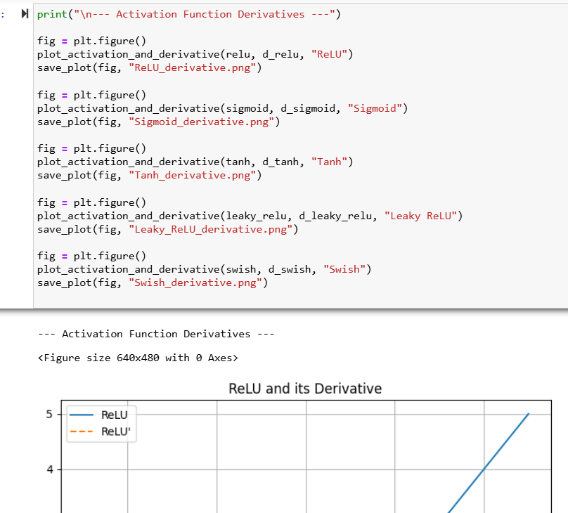
main.py -integrates the full pipeline by importing all modules, setting up CIFAR-10 data, training CNNs with different activation functions, and generating + saving all evaluation plots (loss, accuracy, gradients, derivatives).

Slide 11
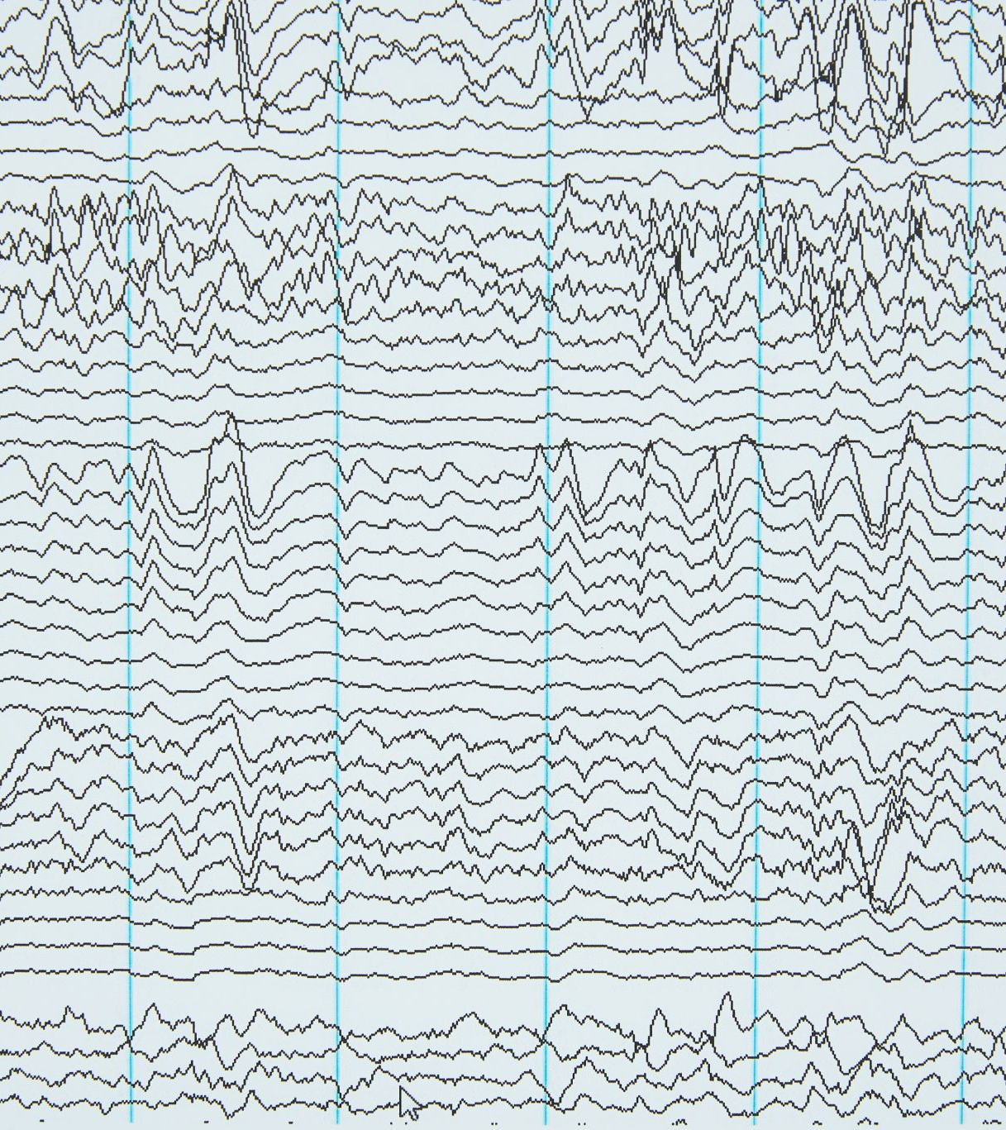
RESULTS – CONVERGENCE SUMMARY LOSS PLOTS

Slide 12
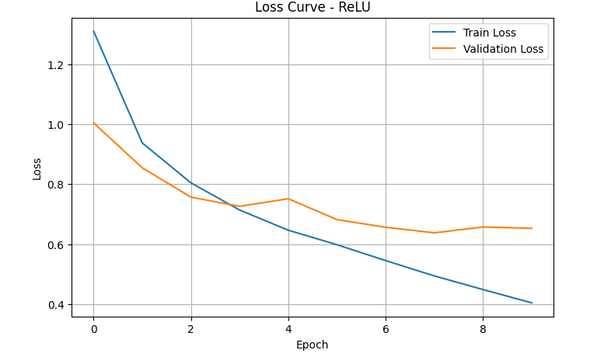
ReLU – Convergence Summary
Fast initial convergence due to simple gradient behavior.
Risk of 'dying neurons' with zero gradient for x < 0.
Validation accuracy reaches ~78%.
Gradient flow remains active but slightly unstable.

Slide 13
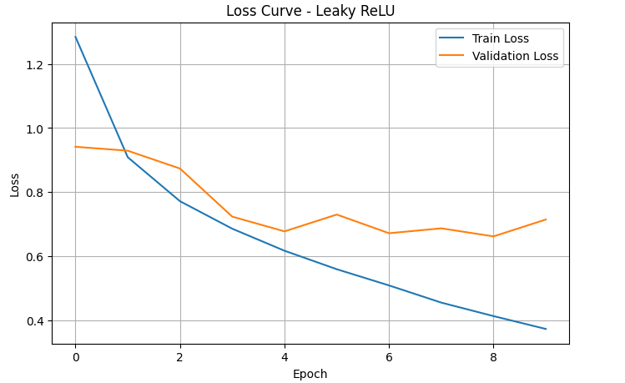
Leaky ReLU – Convergence Summary
Smooth and consistent convergence with strong generalization.
Non-zero slope for negative inputs prevents dead neurons.
Stable gradient norm and validation accuracy around ~78%.

Slide 14
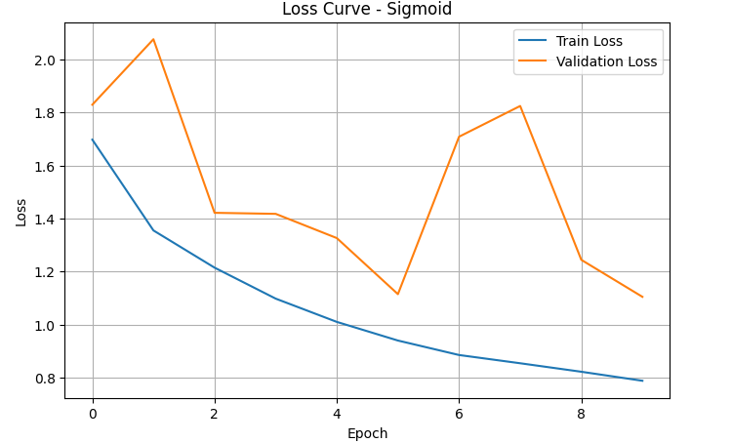
Sigmoid – Convergence Summary
Slow convergence due to saturation for large |x|.
Suffers from vanishing gradients, especially in deep layers.
Validation accuracy unstable and gradients weak early on.

Slide 15
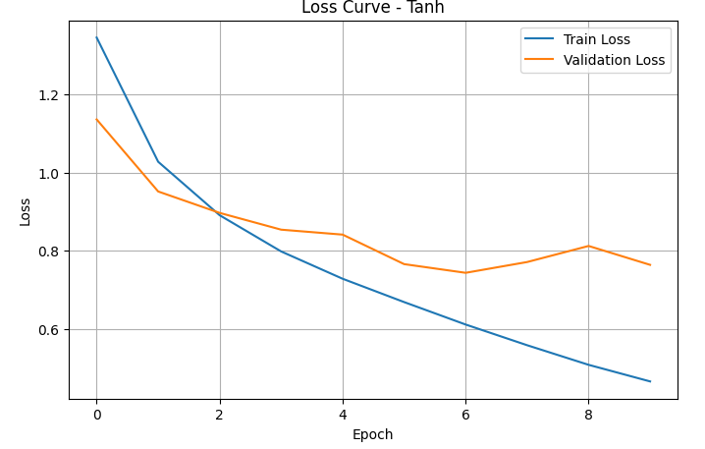
Tanh – Convergence Summary
Moderate convergence, better than sigmoid.
Still suffers from saturation at extreme values.
Consistent validation accuracy with stable learning behavior.

Slide 16
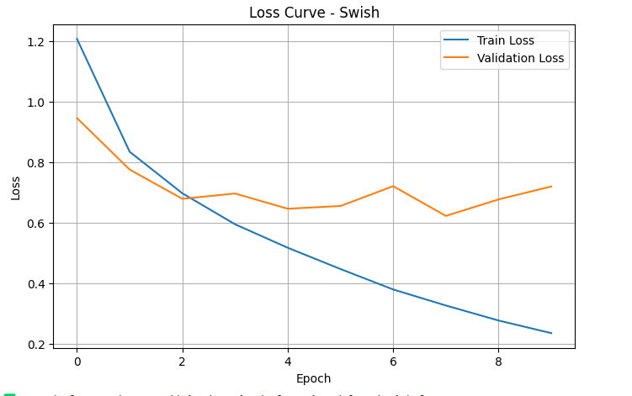
Swish – Convergence Summary
Fastest and smoothest convergence overall.
Non-monotonic and smooth derivative supports gradient flow.
Reaches highest validation accuracy (~80%).

Slide 17
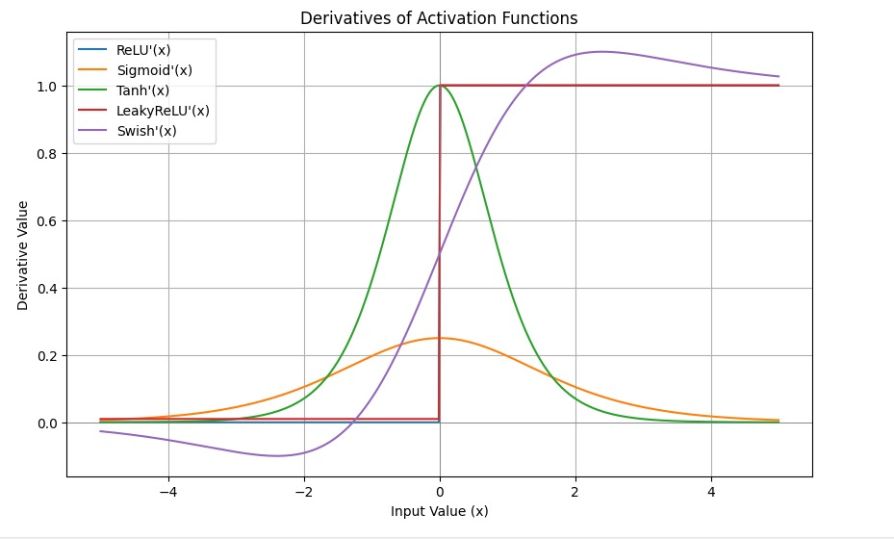
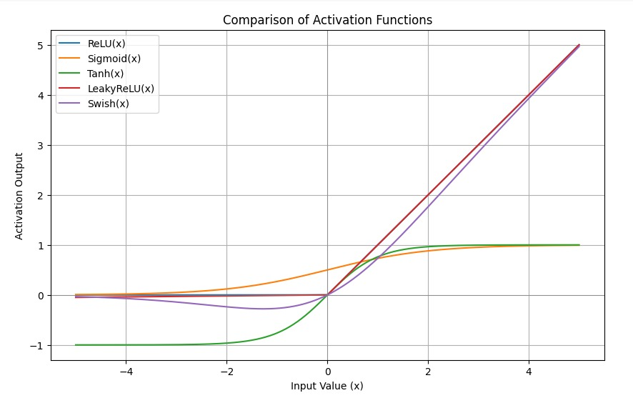
Derivative Comparison – All Activations
Swish and Leaky ReLU maintain non-zero gradients across all inputs.
Sigmoid and Tanh suffer from saturation and vanishing gradients at extremes.
ReLU’s gradient is 0 for x < 0, leading to inactive ('dead') neurons.
Smooth and continuous derivatives improve stability and convergence in deep networks.
Smoothness: Swish, Sigmoid, and Tanh are smooth; ReLU is piecewise.
Non-monotonicity: Only Swish is non-monotonic — helps with exploration in optimization.
Gradient Flow: ReLU and Sigmoid cut off gradients (at x < 0 or saturation); Swish and Leaky ReLU retain them.
Output Range:
Sigmoid: (0, 1)
Tanh: (−1, 1)
ReLU & Leaky ReLU & Swish: [0, ∞) or extend to negatives

Slide 18





RESULTS 1.Accuracy and validation plots 2.First Derivative plots 3.Gradient Norm Flow plots

Slide 19
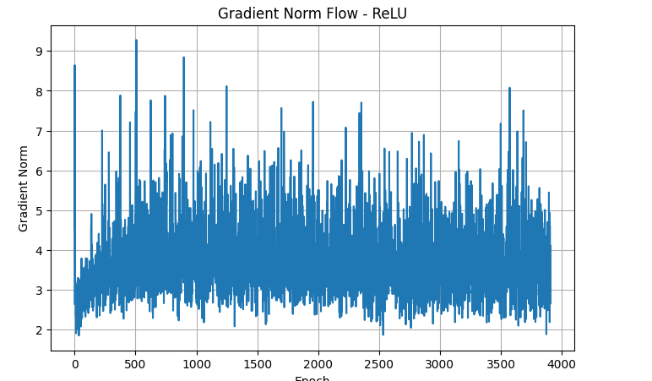
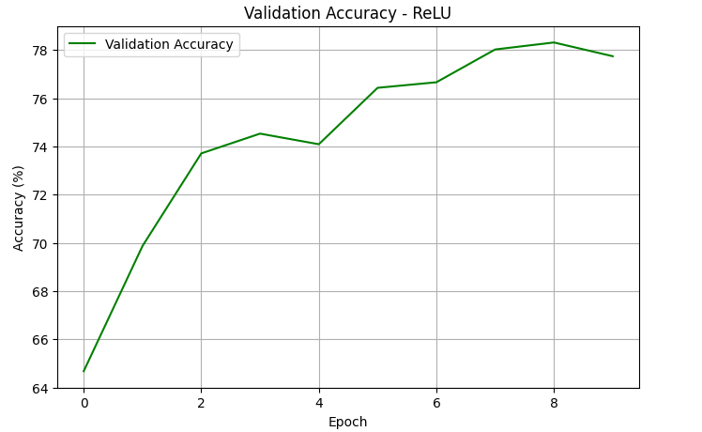
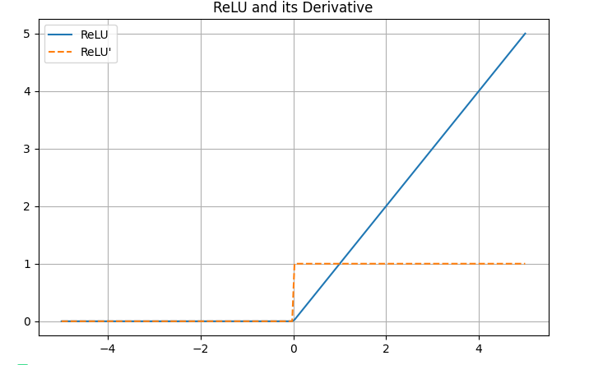
RELU
Gradient Norm Flow
ReLU shows relatively consistent gradient norms during training.
No major vanishing or exploding gradients observed.
Slight instability due to zero gradients for negative inputs (dead neurons risk).
Validation Accuracy
Accuracy improves steadily and reaches ~78% by epoch 9.
Indicates fast and effective convergence in early epochs.
Plateaus slightly toward the end, showing stable generalization.
Activation & Derivative
ReLU output is zero for negative inputs; derivative is 0 → causes “dead neuron” issue.
Positive side has constant derivative (1), promoting fast updates and sharp convergence.

Slide 20
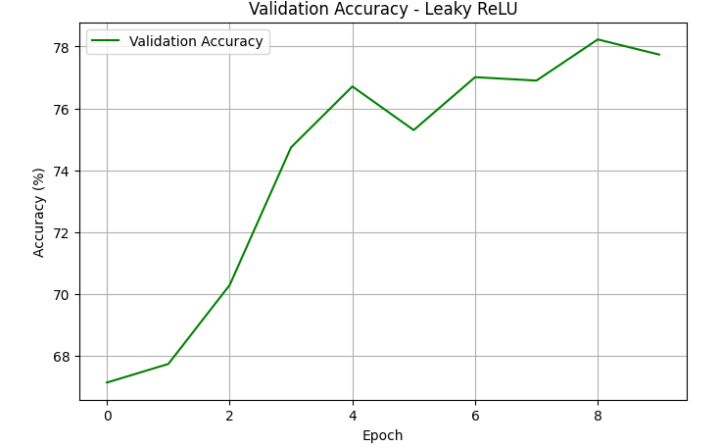
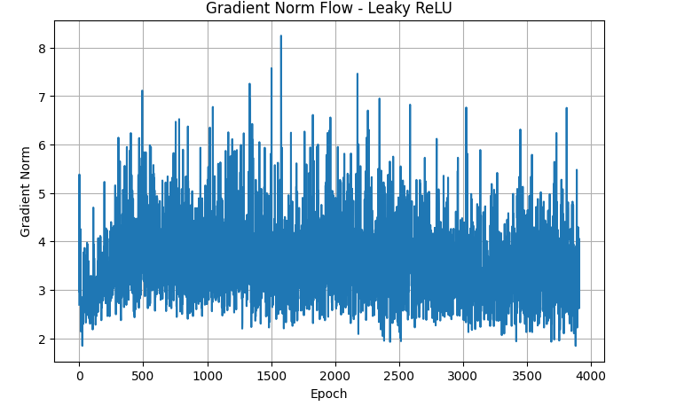
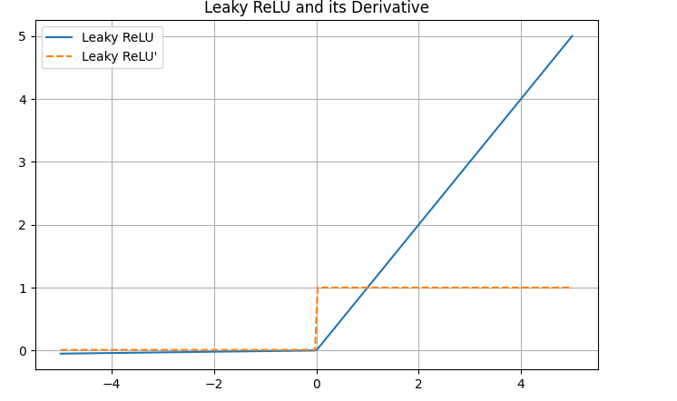
LEAKY RELU
Validation Accuracy
Shows a smooth and steady rise in accuracy, reaching ~78.5%.
Converges almost as fast as ReLU, but with more stability across epochs.
Gradient Norm Flow
Gradient norms are well-maintained and less spiky than ReLU.
No signs of vanishing gradients, thanks to non-zero slope on negative inputs.
Activation & Derivative
Leaky ReLU has a small, non-zero gradient for negative inputs (≈ 0.01).
Prevents the “dead neuron” problem seen in standard ReLU.
Leads to better gradient flow and more robust convergence.

Slide 21
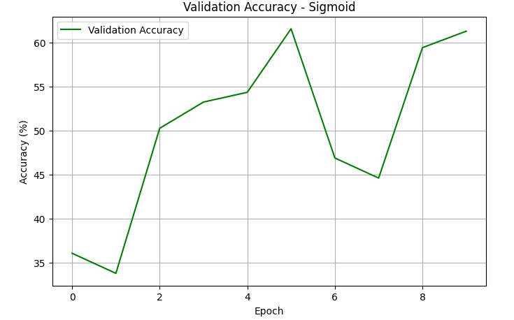
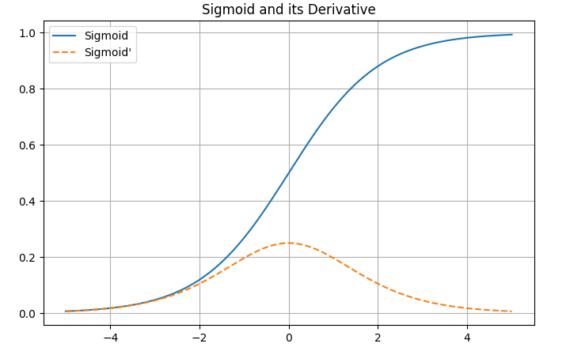
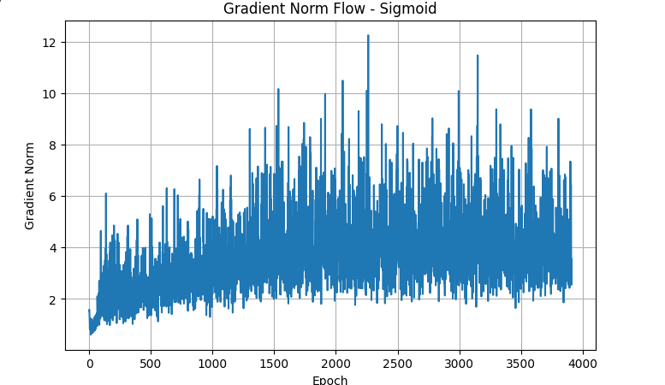
SIGMOID
Validation Accuracy
Starts low (~35%) and improves unevenly, peaking near ~61%.
Accuracy fluctuates significantly — indicating less stable convergence.
Slower and less consistent learning compared to ReLU and Leaky ReLU.
Gradient Norm Flow
Gradients grow gradually but remain lower overall.
Some gradient flow exists, but saturation in extreme values causes vanishing gradients.
Peaks are lower than ReLU or Swish, reflecting weaker signal propagation.
Activation & Derivative
Sigmoid saturates for large positive/negative inputs → gradients approach zero.
Derivative peaks around 0.25 at x=0, and is close to 0 elsewhere.
Causes vanishing gradients, especially in deeper networks.

Slide 22
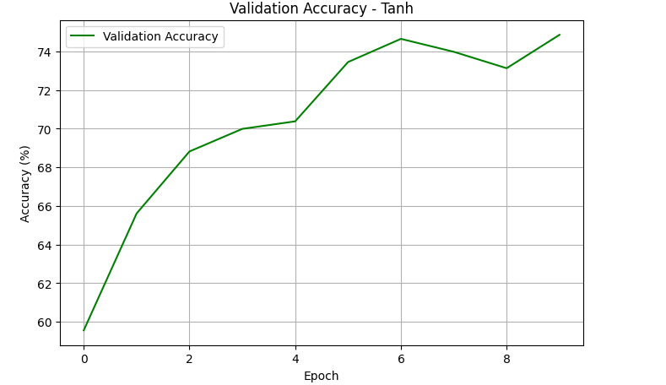
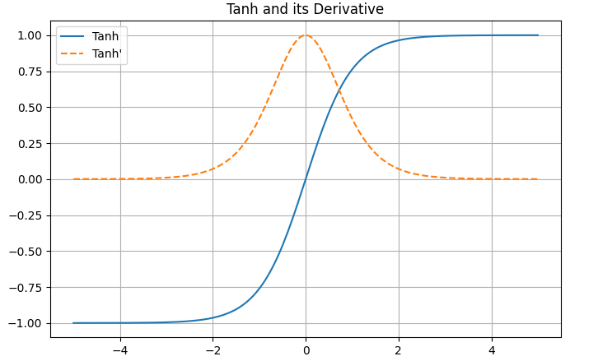
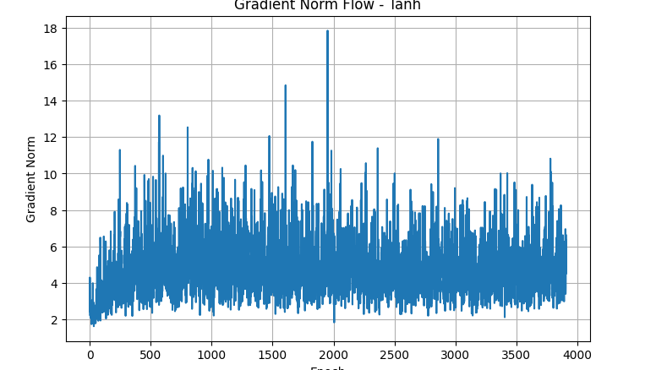
TANH
Validation Accuracy
Starts reasonably high (~60%) and improves steadily.
Reaches around 75%, indicating good learning capability.
Convergence is smoother than Sigmoid, though not as fast as Swish or ReLU.
Gradient Norm Flow
Gradient norms fluctuate but stay mostly moderate to high.
Some spikes indicate active gradient flow.
Still susceptible to vanishing gradients for large inputs.
Activation & Derivative
Tanh outputs are centered around zero, which helps convergence.
Derivative peaks at 1 and falls off symmetrically — still suffers saturation at extremes.
Better than Sigmoid for deep networks but not immune to vanishing gradients.

Slide 23
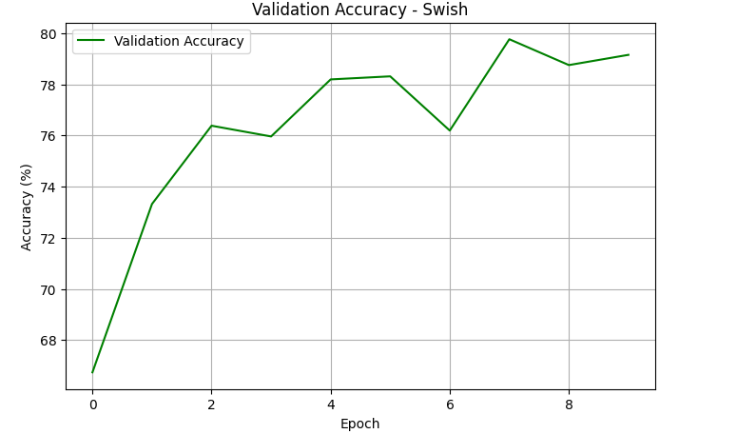
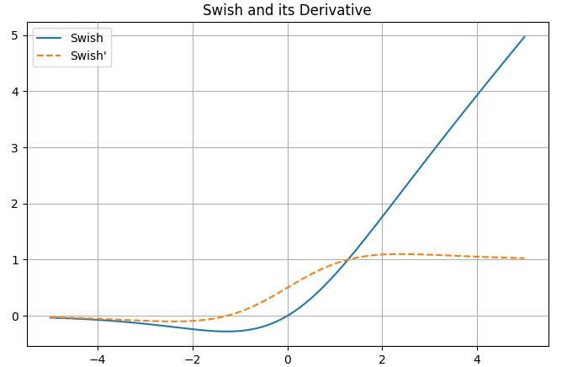
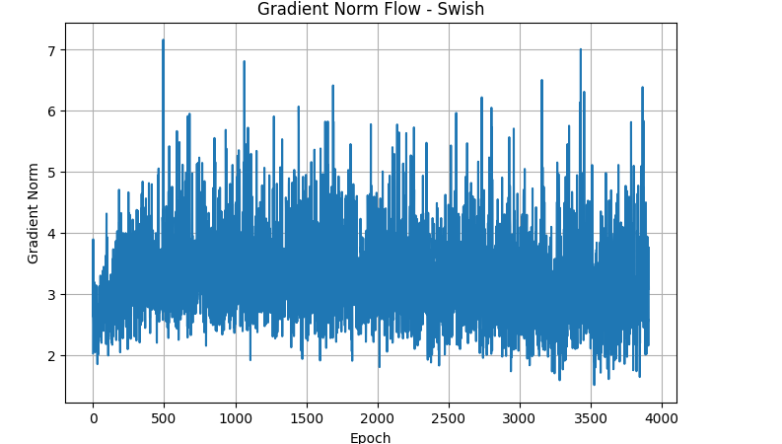
SWISH
Validation Accuracy
Rapid initial rise from ~67% to over 78% by epoch 4.
Peaks near 80%, the highest among all activation functions.
Consistently high accuracy, showing strong generalization and fast convergence.
Gradient Norm Flow
Stable with moderate variance, no extreme spikes or collapses.
Indicates healthy gradient flow throughout training.
Better stability than Sigmoid or Tanh, comparable to Leaky ReLU.
Activation & Derivative
Smooth and non-monotonic, combining properties of ReLU and Sigmoid.
Derivative remains active across a wide range of inputs, avoiding dead zones.
Enables better flow of gradients, aiding deeper network training.

Slide 24

Conclusion
Swish offers the best trade-off in speed, stability, and accuracy — ideal for deep learning.
Leaky ReLU is a safe and computationally efficient default choice.
ReLU works well in shallow networks but requires caution for dying neurons.
Tanh is stable but converges slowly.
Sigmoid is outdated for hidden layers due to poor gradient flow.

Slide 25
THANK YOU

